Slide 1

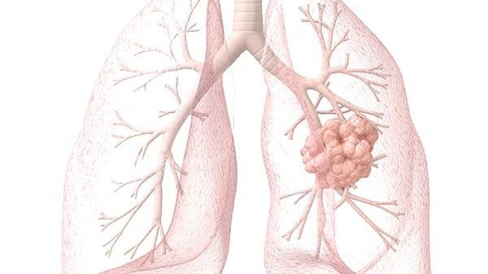

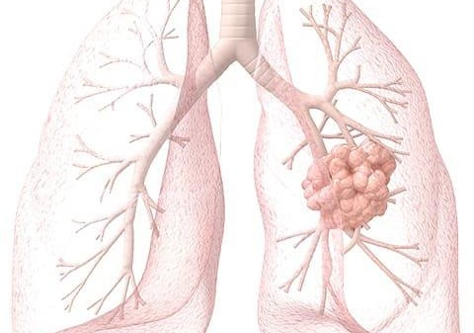
Pathology Image Analysis For Lung Cancer Prediction Using Deep Learning
Presented by: Team no:CSE-005
18 UK1 A0516- GANTA SUCHENDAR
18 UK1 A0525- KANKATI PRANITHA
18 UK1 A0535- MUSHIKA SAIRAM
18 UK1 A0576- JANAGANI VAMSHI KRISHNA

Slide 2
OUTLINE
INTRODUCTION
OBJECTIVE
TECHINICAL ARCHITECTURE
DATA COLLECTION
IMAGE PRE PROCESSING
MODEL BUILDING
NEURAL NETWORKS
SOFTWARE REQUIREMENTS
CONCLUSION

Slide 3
INTRODUCTION
The main objective of this project is to detect whether the tumor present in a patient’s lung is malignant or benign using Convolution Neural Network (CNN)
In a study published in Nature Medicine, researchers said that lung cancer caused an estimated 160,000 deaths in 2018, making it the most common cause of cancer death in the US. Lung cancer screenings that use low-dose tomography have been shown to reduce mortality by 20-43 percent, but there are still challenges that result in unclear diagnoses, subsequent unnecessary procedures, and high costs. Radiologists also usually have to look through dozens of 2D images within a single CT scan, and cancer can be hard to spot. Deep learning can offer a viable solution to these problems.

Slide 4
OBJECTIVES
By the end of this project you will:
Yo u will be get to know about the image processing.
Yo u will be able to understand Deep learning Architecture.
Understand the concepts l ike Artificial neural network and
neural network.
Convolution
Yo u will Classify images using a Convolutional Neural Network.
Yo u will be able to know how to build a web application using the Flask framework.

Slide 5
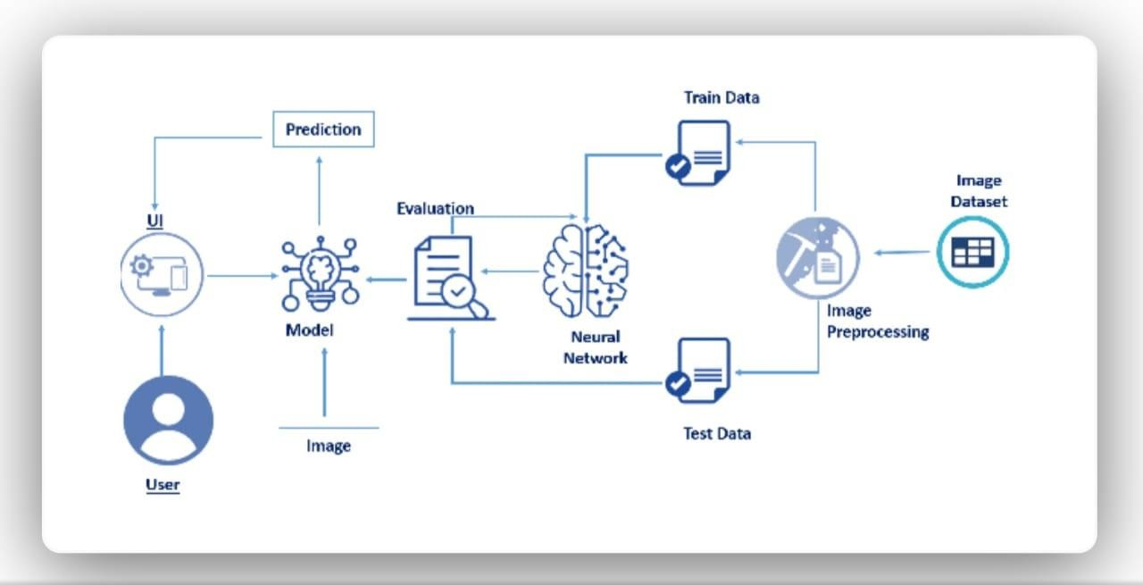
TECHINICAL ARCHITECTURE

Slide 6
DATA COLLECTION
Artificial Intelligence is a data hunger technology, it depends heavily on data, without data, it is impossible for a machine to learn. It is the most crucial aspect that makes
algorithm training possible. In Convolutional Neural Networks, as it deals with images, we need training and testing data set. It is the actual data set used to train the model
for performing various actions.
We will be creating two folders one for training and the other for testing. Images
present in the training folder will be used for building the model and the testing images will be used for validating our model.

Slide 7
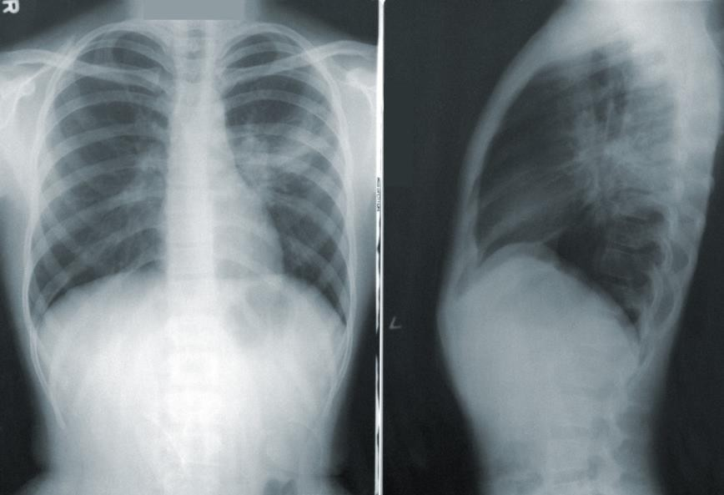
IMAGE PRE PROCESSING
Before t raining the mode l you have to preprocess the ima ges and then feed them on to the model for t raining. we make use of Keras Image Data Generator class for image preprocessing.
Data augmentation in data analysis are techniques used to increase the amount of data by adding slightly modified copies of already existing data or newly created synthetic data from existing data.
Image Pre-processing includes the following main tasks
Import Image Data Generator Library.
Configure Image Data Generator Class.
Applying Image Data Generator functionality to the trainset and test set.

Slide 8
MODEL BUILDING
Model building includes
Import the model building Libraries
Initializing the model
Adding CNN Layers
Adding Dense Layers
Configure the Learning Process
Training the model
Saving the model

Slide 9
MODEL BUILDING DESCRIPTION
Import Libraries
We have to define how our model will look and what it requires.
Initializing The Model
The Sequential class is used to define linear initializations of network layers
Add CNN Layers
It is one of the building blocks of a CNN and is used for extracting important image.
Adding Dense Layer
Configuring The Learning Process
features from the
This means to compile () method of the Sequential mode l class. Compilation requires 3 arguments: an optimizer, a loss function, and a list of metrics.
Training The Model
we have t raining data and a fully configured neural network to t rain with loaded data.
Save The Model
Your model is to be saved for future purposes.

Slide 10


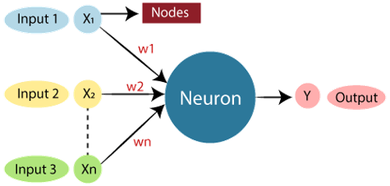
ARTIFICIAL NEURAL NETWORK
The term "Artificial Neural Network" is derived from Biological
neural
networks that develop the structure of a human brain. Similar to the human brain that has neurons interconnected to one another, artificial neural networks also have neurons that are interconnected to one another in various layers of the networks. These neurons are known as nodes.

Slide 11
CONVOLUTIONAL NEURAL NETWORK
A convolutional neural network (CNN) is a type of artificial neural network used in image recognition and processing that is specifically designed to process pixel data. ... A CNN uses a system much like a multilayer perceptron that has been designed for reduced processing requirements.
CNN is a neural network that has one or more convolutional layers and are used mainly for image processing, classification, segmentation and also for other auto correlated data. A convolution is essentially sliding a filter over the input.

Slide 12

OUTPUT
With the help of Artificial Intelligence and Deep Learning we are going to detect the cancer in the earlier stage
click the detect button to
upload the images

Slide 13
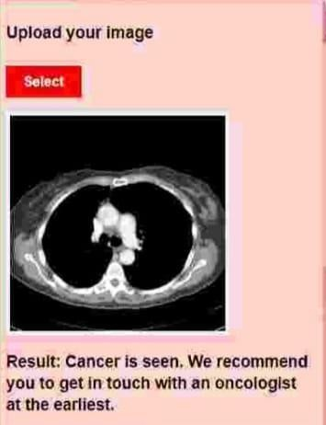
RESULT
The main motto is
"use technology to save lives"

Slide 14
SOFTWARE REQUIREMENTS
Anaconda navigator
Jupyter notebook
Machine learning tools: Numpy,
Matplotlib,
Tensorflow, Keras.

Slide 15
CONCLUSION
In this project we have presented the lung cancer prediction using Deep learning
So, we used artificial neural networks and convolution neural networks to train these images and build a Deep learning model
For better results we applied CNN layers.

